Slide 1
DeepSeek

Slide 2
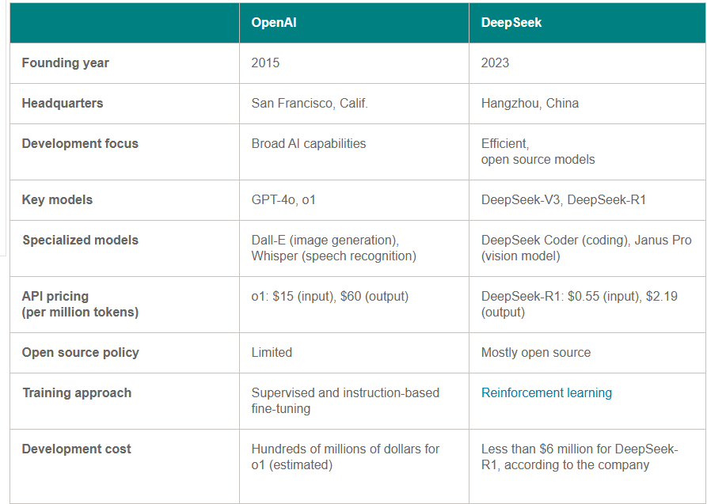
China GenAI DeepSeek(p1)
Deepseek is china company name
On Jan. 20, 2025, DeepSeek released its R1 LLM at a fraction of the cost that other vendors incurred in their own developments.
DeepSeek is also providing its R1 models under an open source license, enabling free use.
As of Feb-2025

Slide 3
Key points of Deep seek
Technical achievement despite restrictions. The export of the highest-performance AI accelerator and GPU chips from the U.S. is restricted to China. Yet, despite that, DeepSeek has demonstrated that leading-edge AI development is possible without access to the most advanced U.S. technology.
Business model threat. In contrast with OpenAI, which is proprietary technology, DeepSeek is open source and free, challenging the revenue model of U.S. companies charging monthly fees for AI services.

Slide 4
Mixture-of-experts (MoE) architecture: Used in DeepSeek, MoE architecture activates only a subset of the model’s parameters and concurrently minimizes the computational resources required for processing the query.
MoE uses 671 billion parameters but activates only 37 billion per query, enhancing computational efficiency. ChatGPT has a monolithic 1.8 trillion-parameter design, suitable for versatile language generation and creative tasks.
Use of 2,000 H800 GPUs for training instead of higher-cost alternatives.

Slide 5
Problems with DeepSeek at initial phase
In a recent cybersecurity incident, Chinese AI startup DeepSeek known for its DeepSeek-R1 large language model (LLM) accidentally exposed over one million sensitive records, including user chat histories, API keys, backend system details, and operational metadata. The breach was identified by cybersecurity firm Wiz Research, which reported that the exposed data was accessible without authentication, posing substantial risks to user privacy and company security.
The exposed databases were hosted at oauth2callback.deepseek.com:9000 and dev.deepseek.com:9000, both of which were accessible without any form of authentication. Anyone with knowledge of the database URLs could have extracted the data. This flaw allowed unauthorized access to the ‘log_stream’ table, which contained over a million log entries.
The ability to execute arbitrary SQL queries through a web interface on these databases posed a significant security risk. Attackers could have extracted plaintext passwords, proprietary data, or potentially escalated their privileges within DeepSeek's infrastructure,

Slide 6
India’s challenges in fully harnessing Gen AI’s capabilities
1. Talent Shortages: There is a gap in AI-specific skills, particularly in areas like prompt engineering and model fine-tuning. 2. Data Access: The availability of structured datasets, especially in local languages, remains limited. 3. High Infrastructure Costs: Compute resources such as GPUs and specialized chips are expensive, creating barriers for smaller players.. 4. Regulatory Uncertainty: Clear policies on data privacy, intellectual property, and AI governance are needed to foster innovation.

